Slide 1

AR Credit Limit Project
User Interface
Ver 1.0
Managed by : LG CNS India
Copyright © LG CNS. Information contained in this document is classified LG Confidential Proprietary. No person outside the LG Group shall have access to the information contained in this document unless business needs dictate, otherwise. It is the responsibility of the person knowing the information contained in this document to ensure confidentiality of information contained in it and preventing unauthorized access to this document at all times

Slide 2
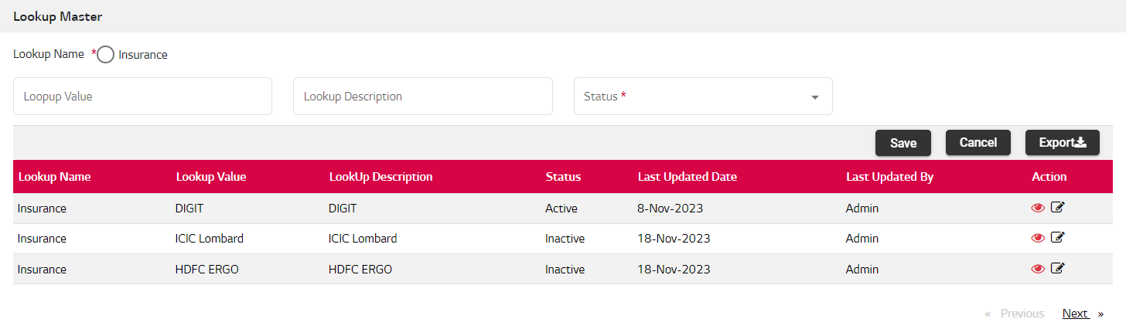
Lookup Master Setup
Page Name | Lookup Master Setup |  |  | Screen ID | CR_1.23.1.4
Access | □All|□Corp. Admin|■CF Admin | Page type | □List | □Content |■Tree | □Other | Window Type | ■Grand | □Popup |□ Tab
Lookup Master Setup
Entry Screen and Grid View
Radio button:- Master Type
Textbox:- Master Type Value
Drop down Status
Save, Cancel Button
Export Button
Paging button
Grid View
New Master screen to manage via Common master page.
Insurance & etc.. under one window
User can change the status as per requirement.
Drop Down | 1
Text Box | 2
Radio button | 1
Button | 8
Grid View | 1
M

Slide 3
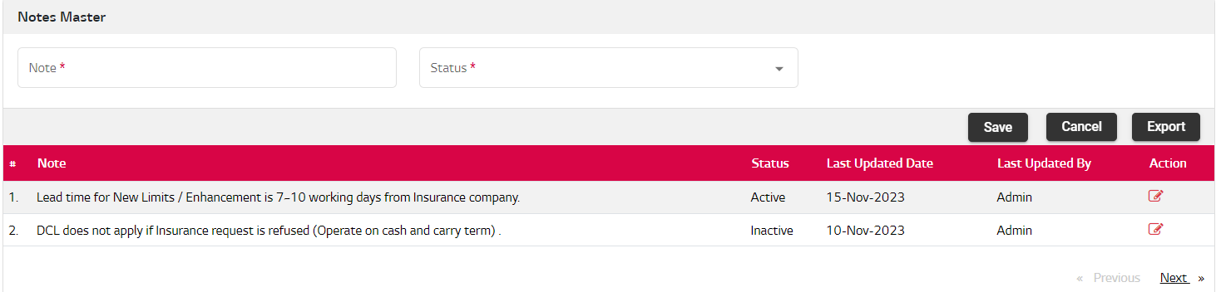
Notes Master
Page Name | Notes Master |  |  | Screen ID | CR_1.23.1.4
Access | □All|□Corp. Admin|■CF Admin | Page type | □List | □Content |■Tree | □Other | Window Type | ■Grand | □Popup |□ Tab
Notes Master
Entry Screen and Grid View
Textbox:- Note detail
Drop down:- Status
Save, Cancel Button
Export Button
Paging button
Grid View
New Master screen to all Notes.
User can change the status as per requirement.
Drop Down | 1
Text Box | 1
Radio button | 0
Button | 7
Grid View | 1
M

Slide 4
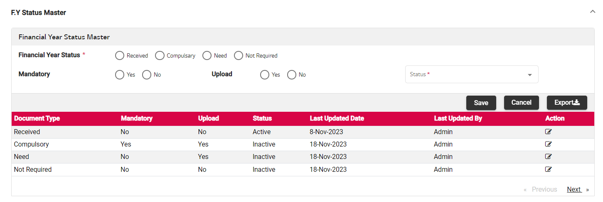
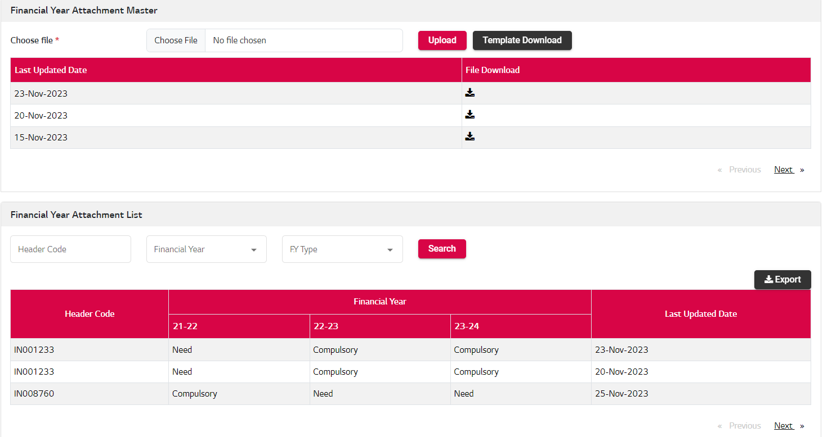
F.Y Status & Enclosed Financial Statement Master
Page Name | F.Y Status & Enclosed Financial Statement Master |  |  | Screen ID | CR_1.23.1.4
Access | □All|□Corp. Admin|■CF Admin | Page type | □List | □Content |■Tree | □Other | Window Type | ■Grand | □Popup |□ Tab
F.Y Status Master
Entry Financial Year Status Master and Grid View
Radio Button:- F.Y Status
Radio Button:- Upload Mandatory
Radio Button:- Upload File Options
Drop down:- Status
Save, Cancel Button
Export Button
Paging button
Grid View
New Master screen to all FY Status Master.
User can change the status as per requirement.
Financial Year Attachment Master
Financial Year Attachment Master and Grid View.
File Upload: F.Y Status upload with HCode
Button: -Template Download & Upload
Text box :- Header Code
Dropdown:- Financial Year
Dropdown:- F.Y Type
Export Button
Paging Button
Grid View
Drop Down | 3
Text Box | 1
Radio button | 3
Button | 17
Grid View | 3
File Upload | 1
VC

Slide 5
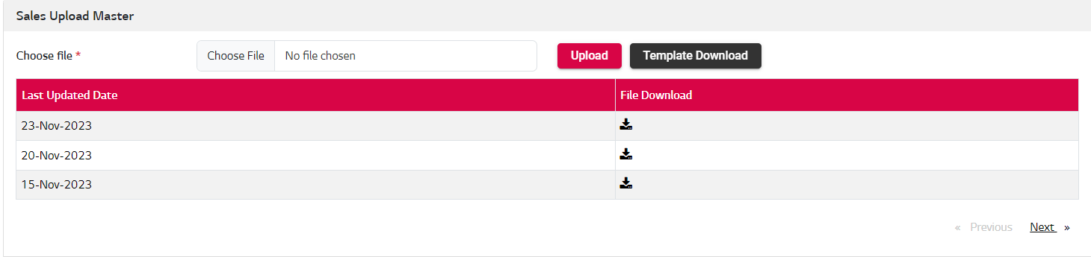
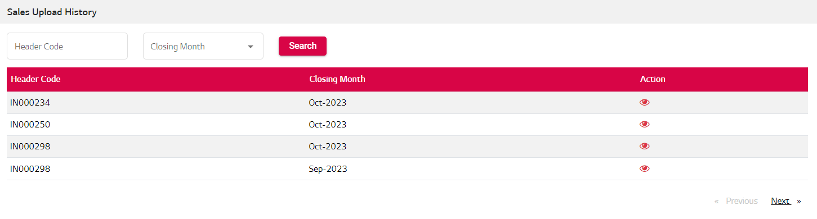
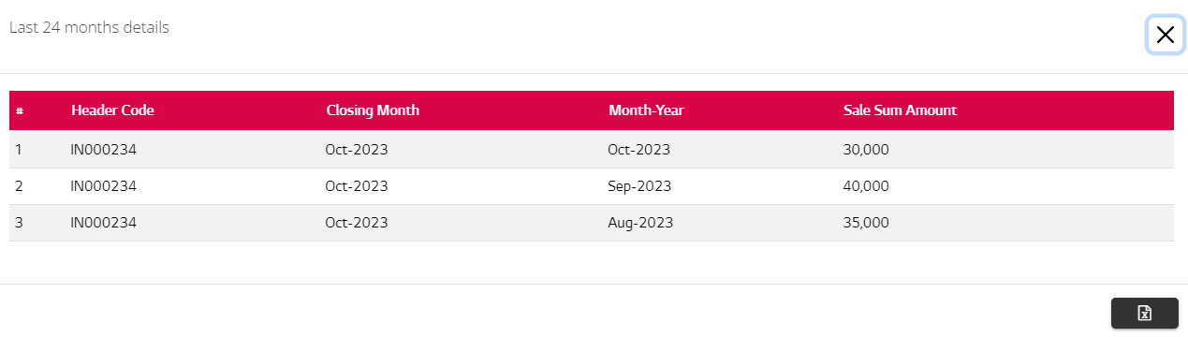
Sales Upload Master
Page Name | Sales Upload Master |  |  | Screen ID | CF_1.23.1.4
Access | □All|□Corp. Admin|■CF Admin | Page type | □List | □Content |■Tree | □Other | Window Type | ■Grand | □Popup |□ Tab
Sales Upload Master
Upload Sales data and Grid View
File Upload
Button :-Template Download & Upload
Button:- Upload File Download
Paging button
Grid View
New Master screen to all Sales Upload Master.
Sales Upload Data History
Sales Upload Data History and Grid View.
Text box :- Header Code
Dropdown:- Closing Month
Button:- Search
View Button:- Popup of Sale Data show
Button:- Export
Paging Button
Grid View
Drop Down | 1
Text Box | 1
Radio button | 0
Button | 10
Grid View | 3
File Upload | 1
VC

Slide 6
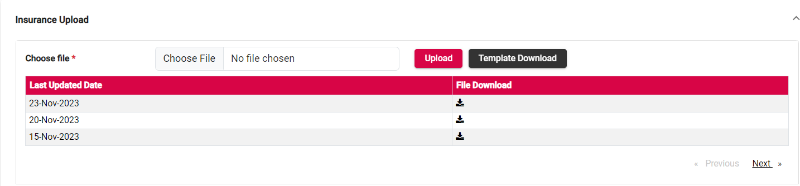
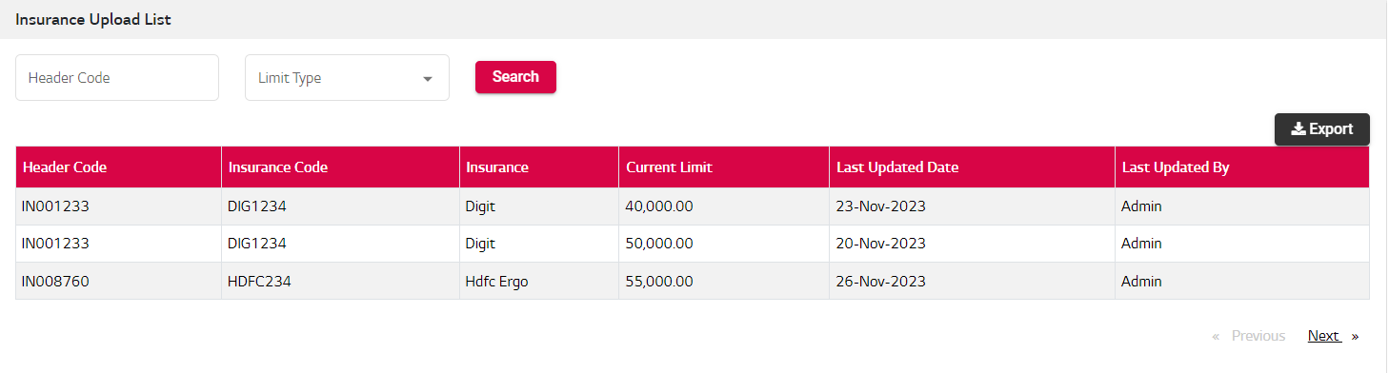
Insurance Master
Page Name | Insurance Master |  |  | Screen ID | CF_1.23.1.4
Access | □All|□Corp. Admin|■CF Admin | Page type | □List | □Content |■Tree | □Other | Window Type | ■Grand | □Popup |□ Tab
Insurance Master
Upload Insurance Details and Grid View
File Upload
Button :-Template Download & Upload
Download Button:- Uploaded File
Paging button
Grid View
New Master screen to all Insurance Master.
Insurance Upload List
Insurance Upload List and Grid View.
Text box :- Header Code
Dropdown:- Record Type
Button:- Search & Export
Paging Button
Grid View
Drop Down | 1
Text Box | 1
Radio button | 0
Button | 9
Grid View | 2
File Upload | 1
M

Slide 7
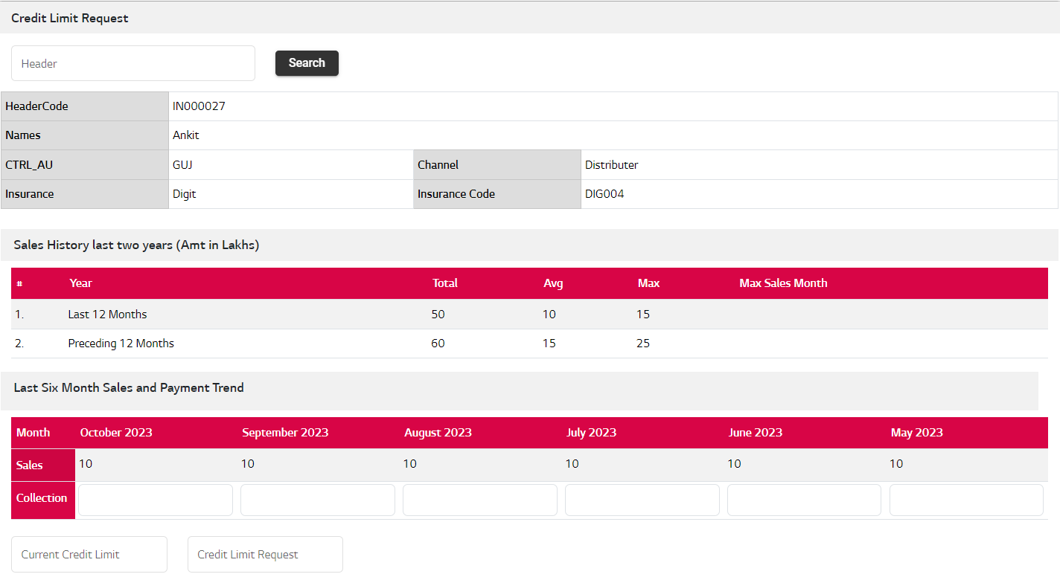
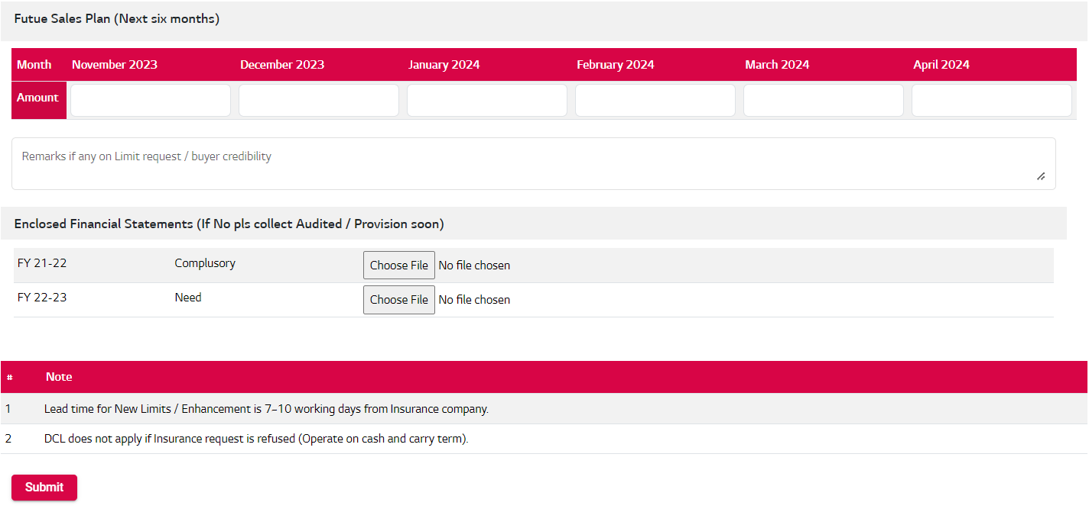
Credit Limit New Request
Page Name | Credit Limit New Request |  |  | Screen ID | CF_1.23.1.4
Access | □All|□Corp. Admin|■CF Admin | Page type | □List | □Content |■Tree | □Other | Window Type | ■Grand | □Popup |□ Tab
Credit Limit New Request
Entry Credit Limit New Request and Grid View
Textbox:- Header Code
Button :-Search
Textbox:- Collection Last 6-month payment
Textbox:- Current Credit Limit
Textbox:- Credit Limit Request
Textbox :- Amount of next 6-month sales
Text area :- Remark
File Upload :- Attachment Document
Button:- Submit
Paging button
Grid View
Any New Credit Limit Requests Register here by Only Branch. After submit record edit not allowed.
Drop Down | 0
Text Box | 13
Radio button | 0
Button | 2
Grid View | 5
File Upload | 2
VC

Slide 8
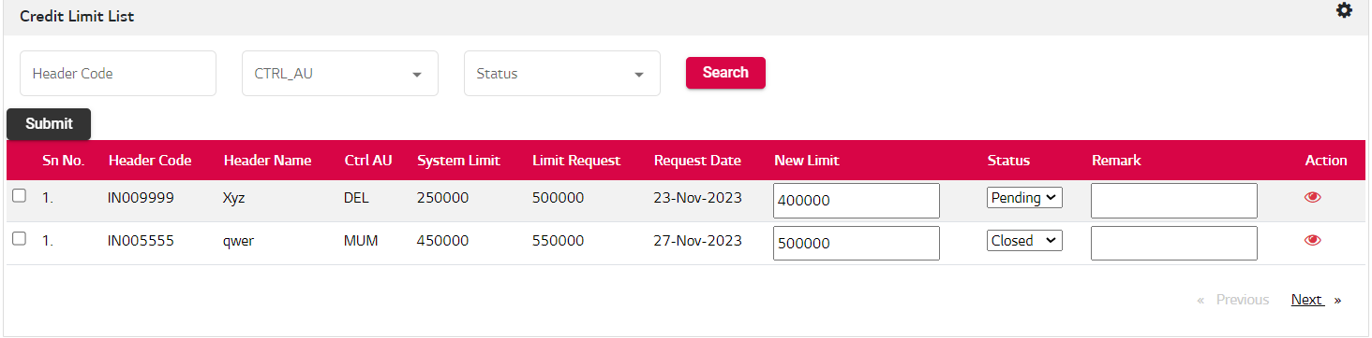
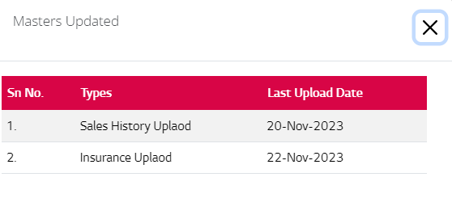
Credit Limit List
Page Name | Credit Limit List |  |  | Screen ID | CF_1.23.1.4
Access | □All|□Corp. Admin|■CF Admin | Page type | □List | □Content |■Tree | □Other | Window Type | ■Grand | □Popup |□ Tab
Credit Limit List
Search Credit Limit List and Grid View
Textbox:- Header Code
Textbox:- CTRL_AU
Dropdown:- Current Status
Button:- Search (search records)
Button:- Submit (Update Status & Limits)
Checkbox:- Selection of records in Grid view
Textbox:- New Limit Assign
Dropdown:- Current Status
Textbox:- HO Remarks
Button:- Submit
Paging button
Grid View
Search all Credit Limit Requests which is register by Branch.
HO can change the Status & New Limits of Requests.
View Details of Request on click “eye” icon.
Masters Updated Details (Only for HO)
Master Updated List and Grid View
Grid View
.
Drop Down | 3
Text Box | 3
Radio button | 0
Button | 4
Grid View | 2
Checkbox | 1
C

Slide 9
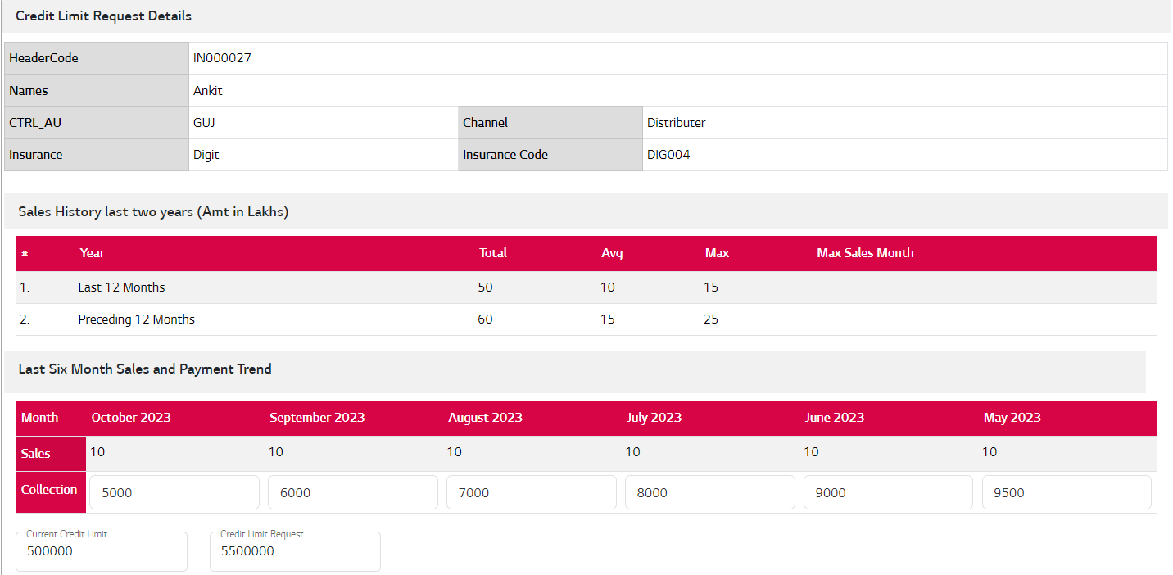
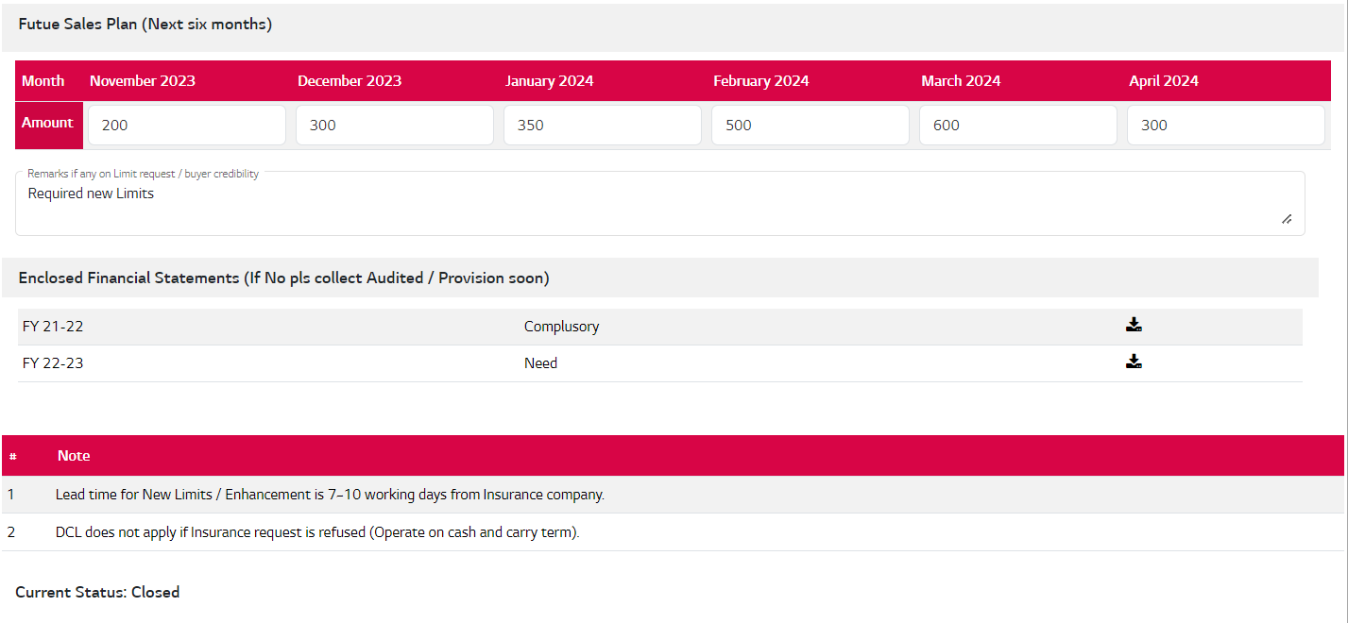
Credit Limit Request View Details
Page Name | Credit Limit View Details |  |  | Screen ID | CF_1.23.1.4
Access | □All|□Corp. Admin|■CF Admin | Page type | □List | □Content |■Tree | □Other | Window Type | ■Grand | □Popup |□ Tab
Credit Limit Request View Details
Credit Limit Request Details & Grid View
Request of details only view here, which is requested by Branch & also after take action by HO.
Drop Down | 0
Text Box | 0
Radio button | 0
Button | 2
Grid View | 5
File Upload | 0
Label for data show | 20
C

Slide 10
Thank You

